Slide 1
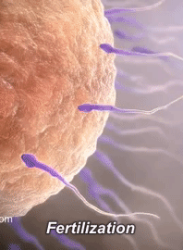
Spermatogenesis and oogenesis
AEHBY Human Biology

Slide 2
Review
List the 5 main hormones of the human reproductive system and for each state the source and receptor (10 marks)
Compare and contrast mitosis and meiosis (10 marks)
Describe three sources of variation that occur during meiotic divisions (6 marks)
Explain potency of stem cells. (4 marks)

Slide 3
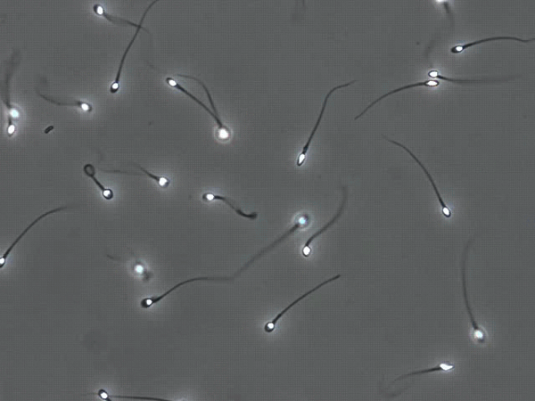
Learning Intentions
Human gametes are produced through spermatogenesis and oogenesis, which are specific forms of meiosis, but varying significantly in process and products

Slide 4
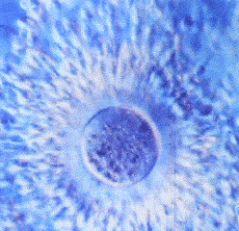
Success criteria
Describe the process and location of spermatogenesis and oogenesis.
Distinguish between spermatogonia, primary and secondary spermatocytes, spermatids, Sertoli cells and spermatozoa.
Distinguish between oogonia, primary and secondary oocytes and polar bodies.
Compare and contrast spermatogenesis and oogenesis.

Slide 5
Spermatogenesis
Sperm formation occurs in the seminiferous tubules of the testes. Every day from puberty, a healthy male makes several hundred million sperm, with rapid and constant cellular divisions.
Spermatogenesis involves meiosis, to reduce the number of chromosomes to the haploid (23 in humans).

Slide 6
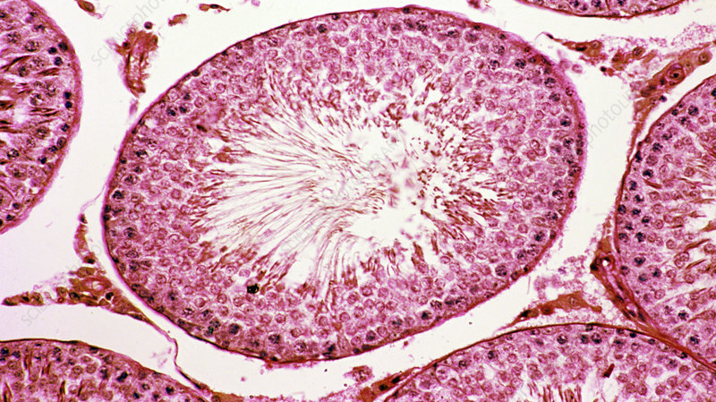

Slide 7
Cell divisions
Each seminiferous tubule is lined with undifferentiated stem cells called spermatogonia or “sperm seed”. Until puberty, these divide continuously by mitosis, but after puberty each mitotic division produces one germ cell and one primary spermatocyte.
Primary spermatocytes undergo meiosis I to produce secondary spermatocytes and then meiosis II to product spermatids.

Slide 8
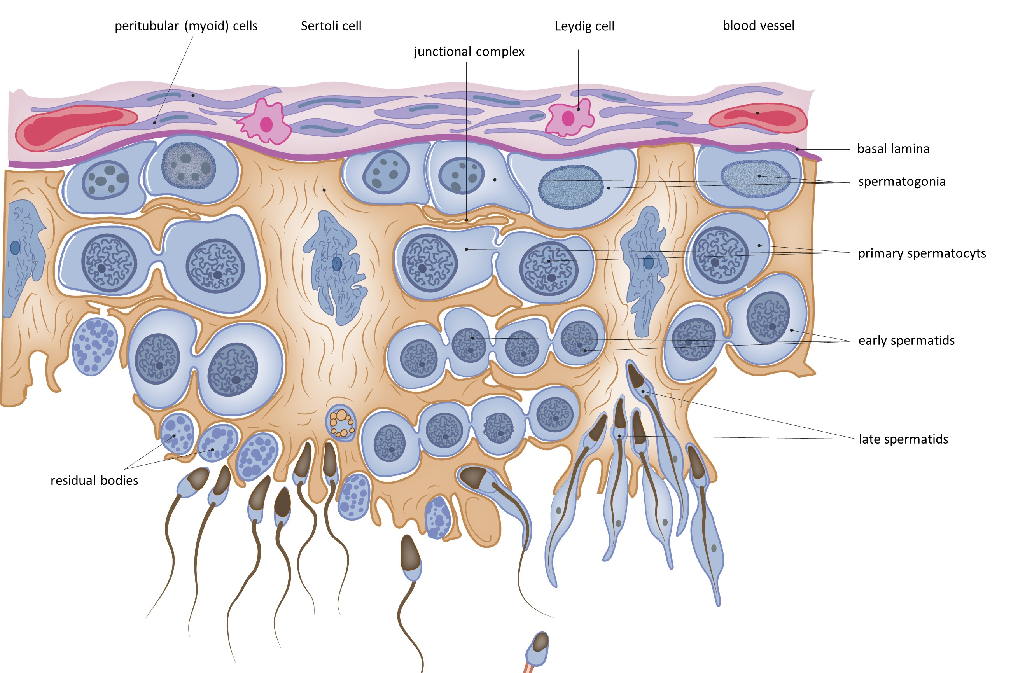

Slide 9
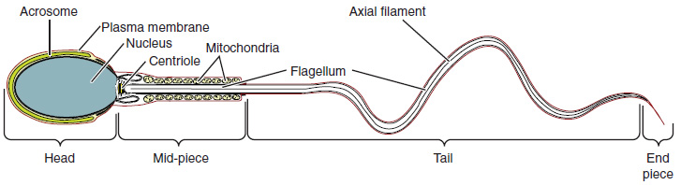
Spermiogenesis
Spermatids undergo a streamlining process to remove excess cytoplasm and develop into spermatozoa with three parts: the DNA filled head, metabolic midpiece full of mitochondria and a motile tail.
This Photo by Unknown Author is licensed under CC BY

Slide 10
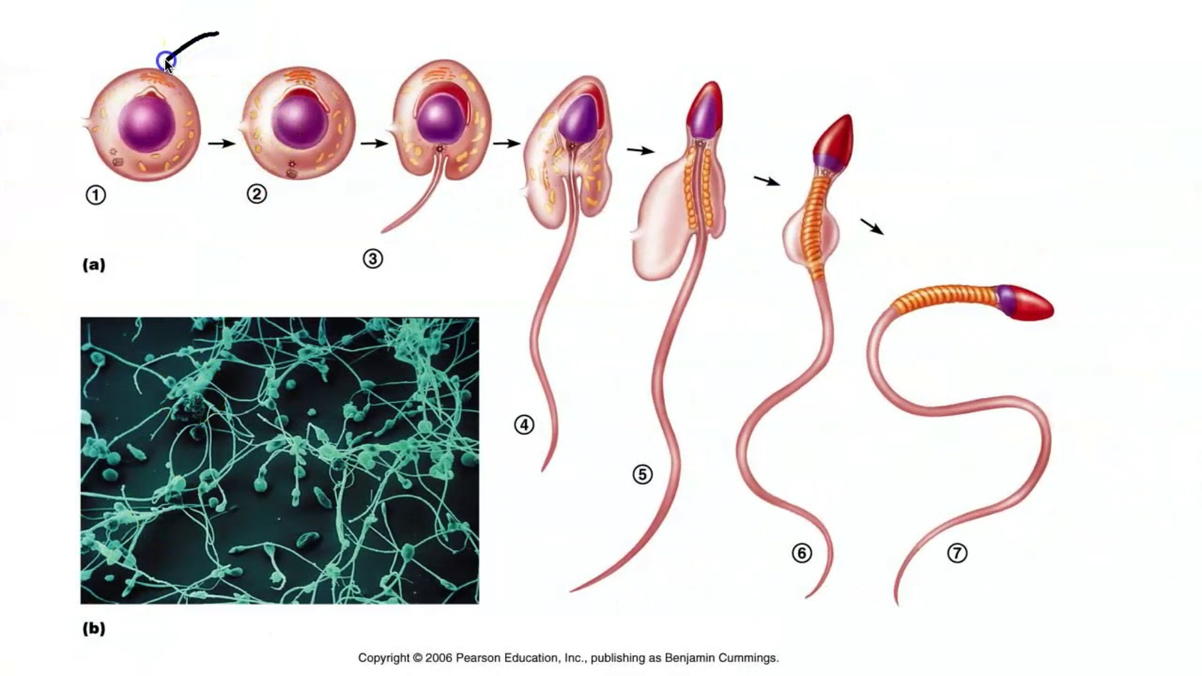

Slide 11
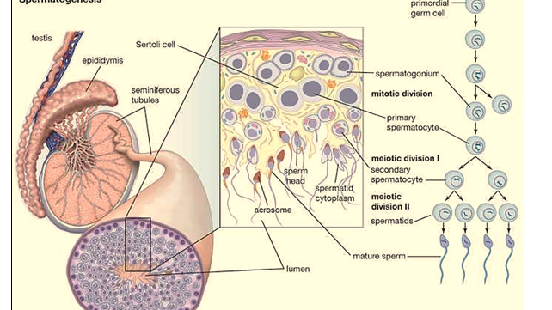

Slide 12
Sertoli cells
Support cells, called Sertoli or sustentacular cells, also arise from the primary spermatocytes, and form the blood-testis barrier. This prevents the sperm from entering the blood stream or the immune system attacking the sperm, in addition to passing nutrients to the developing sperm, regulating sperm production and producing liquid for the sperm to swim in.

Slide 13
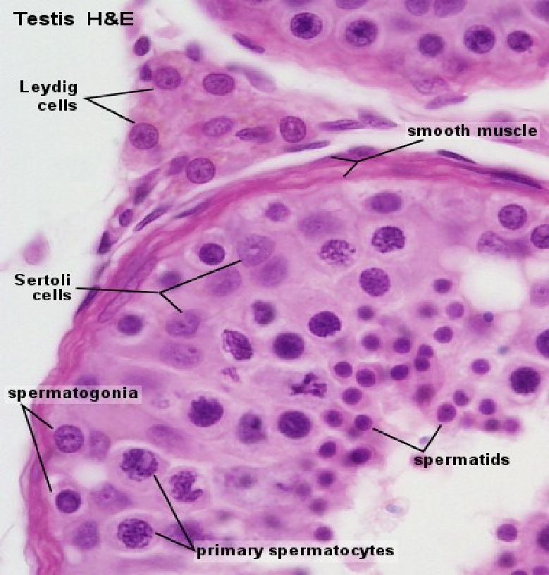

Slide 14
Oogenesis
Oogonia are stem cells in the ovaries that undergo rapid mitosis during foetal development. Primordial follicles appear as the oogonia are transformed into primary oocytes surrounded by follicle cells. They begin meiosis, but stall in late prophase I and remain so until after puberty.

Slide 15
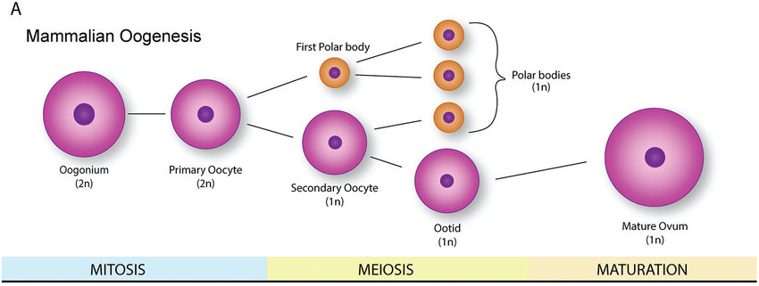

Slide 16
Polar bodies and secondary oocytes
Each month after puberty, a primary oocyte continues meiosis I to produce two haploid cells: one large secondary oocyte and one very small polar body.
The polar body undergoes meiosis II to produce two even smaller polar bodies, while the secondary oocyte is ovulated.

Slide 17
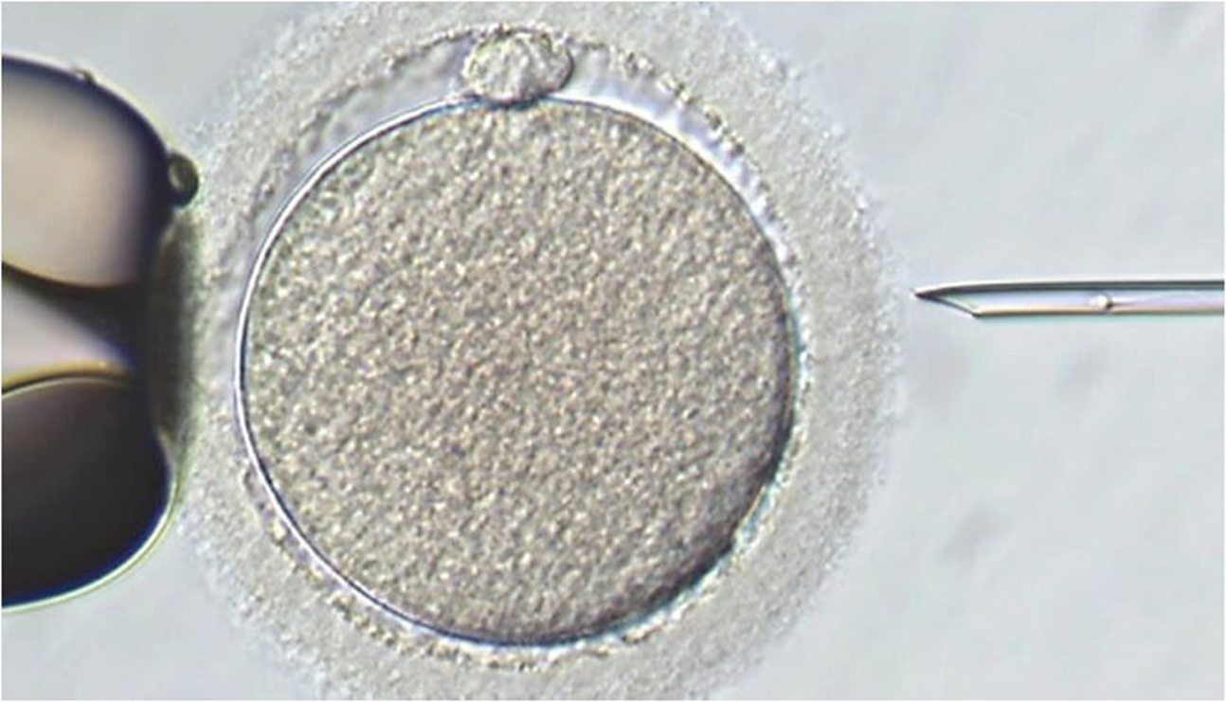

Slide 18
If a sperm penetrates its zona, the secondary oocyte will undergo meiosis to produce an ovum and another very small polar body.
From a primary oocyte, one ovum will be produced accompanied by three polar bodies.

Slide 19
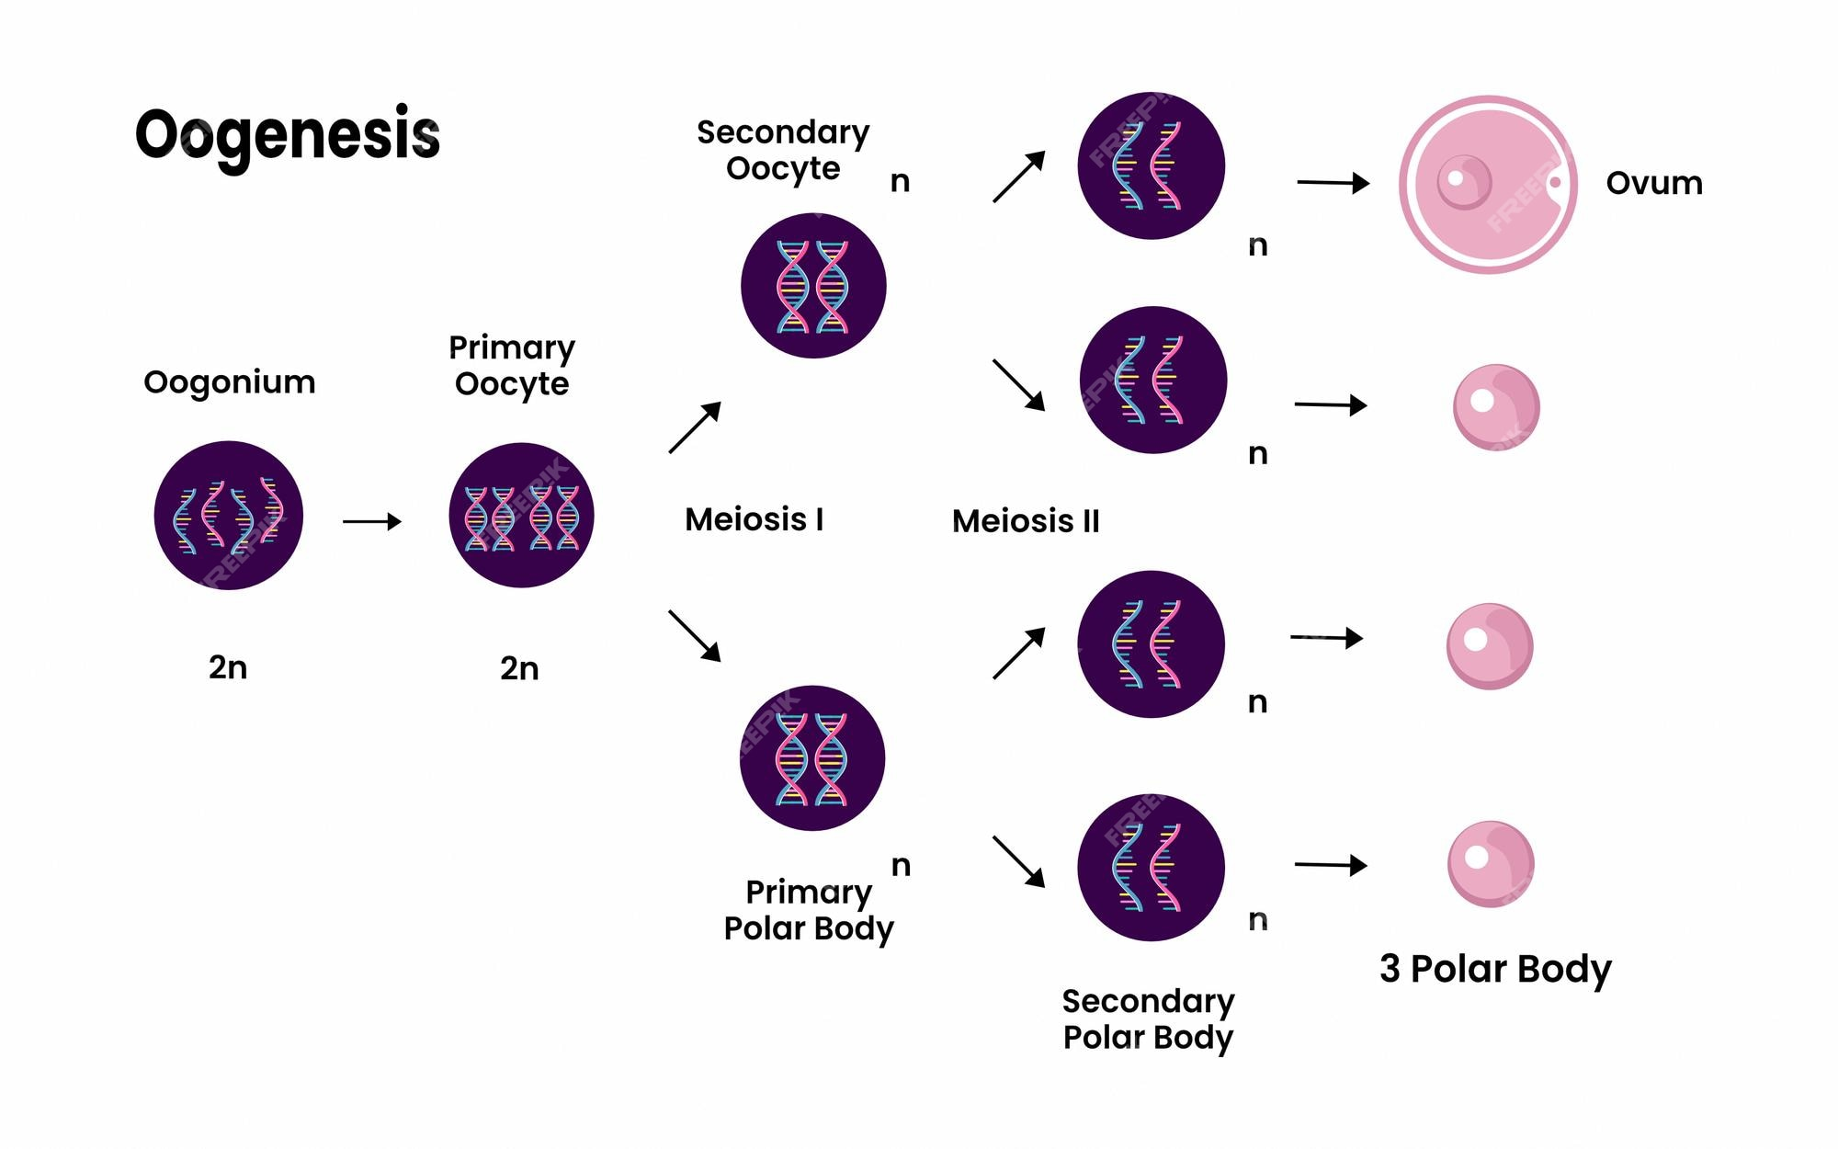

Slide 20
Success criteria
Describe the process and location of spermatogenesis and oogenesis.
Distinguish between spermatogonia, primary and secondary spermatocytes, spermatids, Sertoli cells and spermatozoa.
Distinguish between oogonia, primary and secondary oocytes and polar bodies.
Compare and contrast spermatogenesis and oogenesis.

